Slide 1
Information Security Fundamentals: Essential Practices for Protecting Digital Assets
Key strategies for safeguarding digital information
Notes:
AI-generated content may be incorrect. --- In today's digital world, safeguarding our digital assets is crucial. This presentation will cover essential practices for information security, focusing on protecting computers, networks, communications, and personal privacy.

Slide 2
Agenda Items
Protecting Your Computer and Its Content
Securing Computer Networks and Handling Compromised Computers
Secure Communications
Information Security Best Practices
Privacy Guidelines
Safe Internet Usage
Notes:
We will explore key topics, including how to protect your computer and its content, secure computer networks, ensure secure communications, implement best practices, understand privacy guidelines, and promote safe internet usage. Each section will provide actionable insights to enhance your information security.

Slide 3
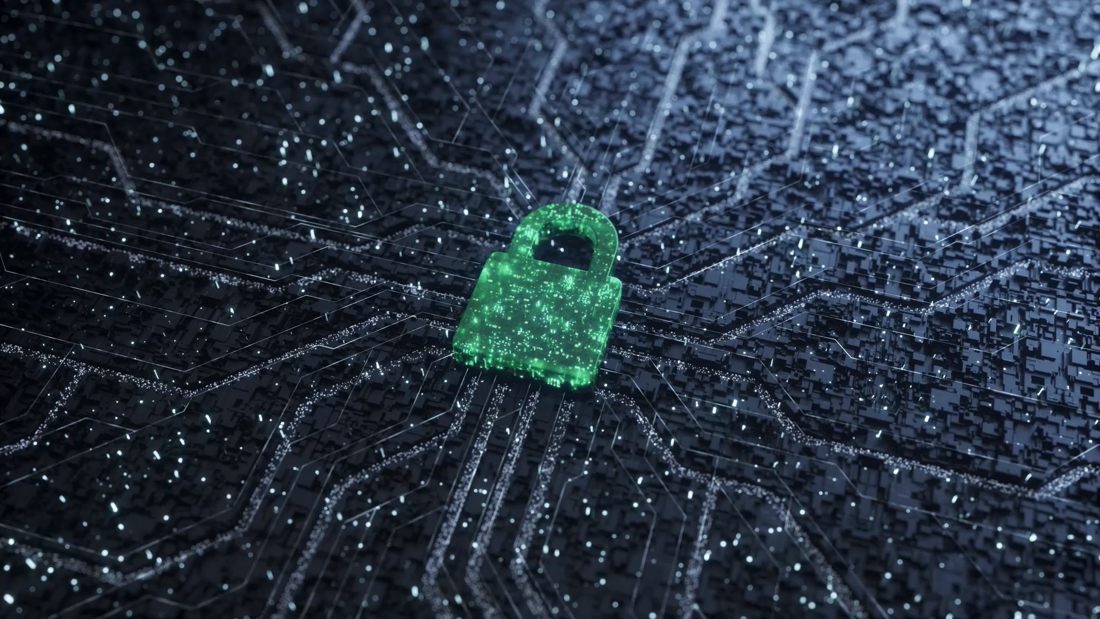
INFORMATION SECURITY BASICS

Slide 4
Information, Computer & Network Security
Information Security refers to the protection of available information or information resources from unauthorized access, attack, theft, or data damage.
Responsible individuals and organizations must secure their confidential information.
Computer security is the protection of computer systems and information from harm, theft, and unauthorized use.
Network security is the protection of the underlying networking infrastructure from unauthorized access, misuse, or theft.

Slide 5
Key Objectives of Computer Security
Confidentiality:
Confidentiality is about keeping certain information private and secure, so only authorized people can access it.
A loss of confidentiality is the unauthorized disclosure of information
This term covers two related concepts:
Data confidentiality: Assures that private or confidential information is not made available or disclosed to unauthorized individuals.
Privacy: Assures that individuals control or influence what information related to them may be collected and stored and by whom and to whom that information may be disclosed

Slide 6
Integrity:
Guarding against improper information modification or destruction, including ensuring information nonrepudiation and authenticity. A loss of integrity is the unauthorized modification or destruction of information.
This term covers two related concepts:
Data integrity: Assures that information (both stored and in transmitted packets) and programs are changed only in a specified and authorized manner.
System integrity: Assures that a system performs its intended function in an unimpaired manner, free from deliberate or inadvertent unauthorized manipulation of the system.
Availability: Assures that systems work promptly and service is not denied to authorized users.

Slide 7
Goal of Information Security
Information Security Goal | Description
Prevention | Personal information, company information, and information about intellectual property must be protected.
Detection | Detection occurs when a user is discovered trying to access unauthorized data or after information has been lost
Recovery | When there is a disaster or an intrusion by unauthorized users, system data can become compromised or damaged. It is in these cases that you need to employ a process to recover vital data from a crashed system or data storage devices

Slide 8
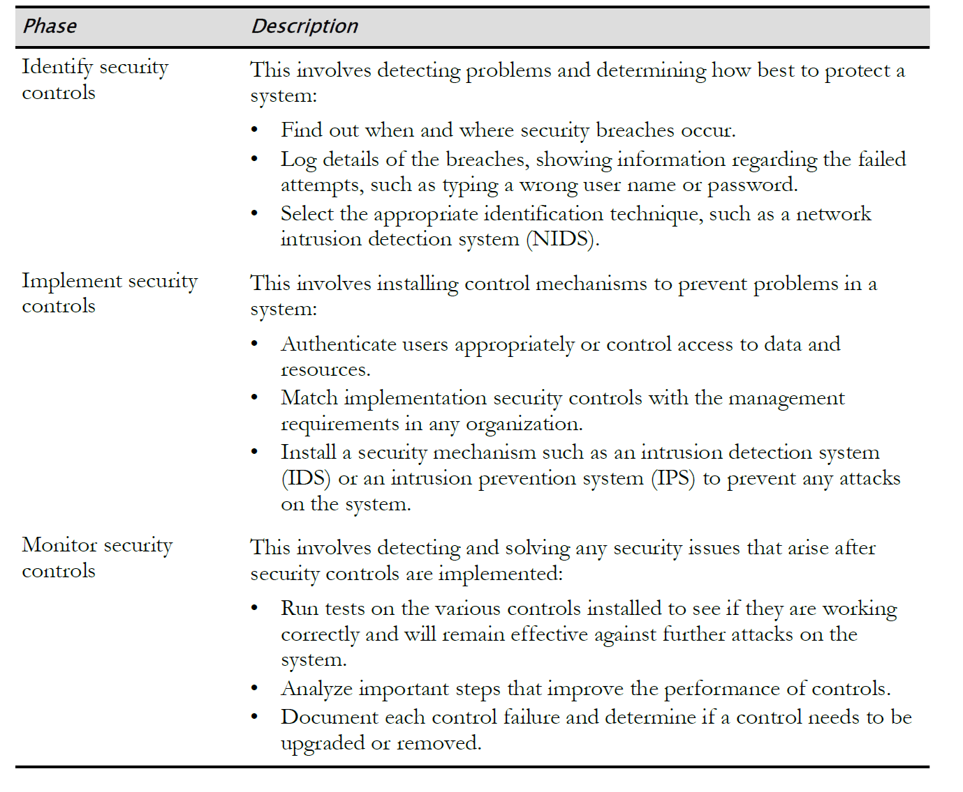
Security Management Process

Slide 9
IDENTIFYING BASIC SECURITY CONTROLS

Slide 10
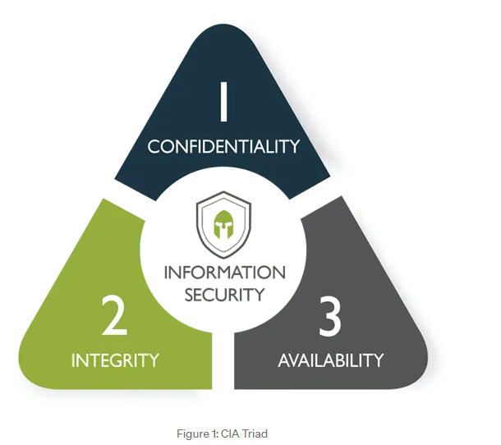
CIA Triad
Information security seeks to address three specific principles: Confidentiality, integrity and availability, also known as the CIA triad.
If one of the principle is compromised, the security of the organization is threatened.
The model is also sometimes referred to as the AIC triad (availability, integrity and confidentiality) to avoid confusion with the Central Intelligence Agency.

Slide 11
CIA Triad
Principle | Description
Confidentiality | This is the fundamental principle of keeping information and communications private and protected from unauthorized access. Confidential information includes trade secrets, personnel records, health records, tax records, and military secrets. Confidentiality is typically controlled through encryption, access controls, and steganography
Integrity | This is the fundamental principle of keeping organizational information accurate, free of errors, and without unauthorized modifications. Integrity is typically controlled through hashing, digital signatures, certificates, and change control.
Availability | This is the fundamental principle of ensuring that computer systems operate continuously and that authorized persons can access the data that they need. Availability is typically controlled through redundancy, fault tolerance, and patching

Slide 12
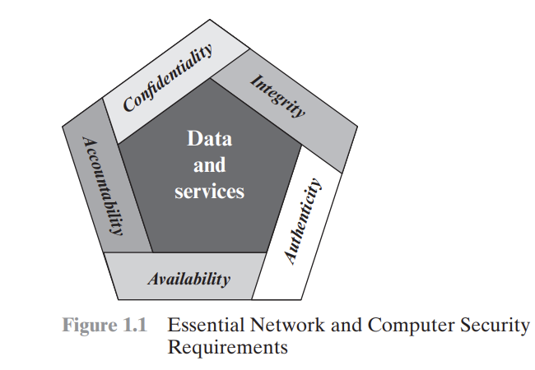
Cont…
Although the use of the CIA triad to define security objectives is well established, some in the security field feel that additional concepts are needed to present a complete picture (as shown in the figure). Two of the most commonly mentioned are as follows:
Authenticity: The property of being genuine and being able to be verified and trusted; confidence in the validity of a transmission, a message, or message originator. This means verifying that users are who they say they are and that each input arriving at the system came from a trusted source.
Accountability: The security goal that generates the requirement for actions of an entity to be traced uniquely to that entity. This supports nonrepudiation, deterrence, fault isolation, intrusion detection and prevention, and after action recovery and legal action.

Slide 13
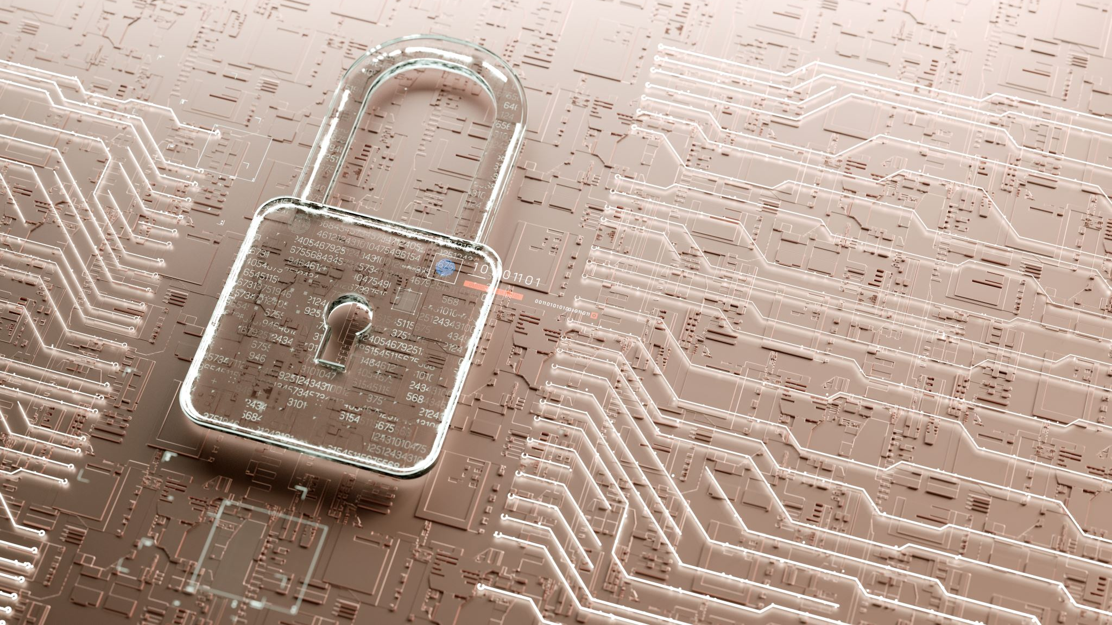
Fundamental Concepts of Security

Slide 14
Vulnerabilities
At the most basic level, a vulnerability is any condition that leaves an information system open to harm.
It is the weakness, flaw or other shortcoming of a system.
Vulnerabilities can come in a wide variety of forms, including:
• Improperly configured or installed hardware or software.
• Delays in applying and testing software and firmware patches.
• Untested software and firmware patches.
• Bugs in software or operating systems.
• The misuse of software or communication protocols.
• Poorly designed networks.
• Poor physical security.
• Insecure passwords.
• Design flaws in software or operating systems.
• Unchecked user input

Slide 15
Threats
In the realm of computer security, a threat is any event or action that could potentially cause damage to an asset or anything that could exploit a vulnerability which could break CIA triad.
Threats are often in violation of a security requirement, policy, or procedure.
Regardless of whether a violation is intentional or unintentional, malicious or not, it is considered a threat.
Potential threats to computer and network security include:
• Unintentional or unauthorized access or changes to data.
• The interruption of services.
• The interruption of access to assets.
• Damage to hardware.
• Unauthorized access or damage to facilities.

Slide 16
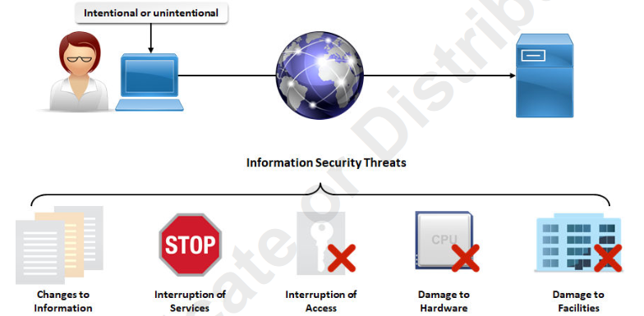
Threats

Slide 17
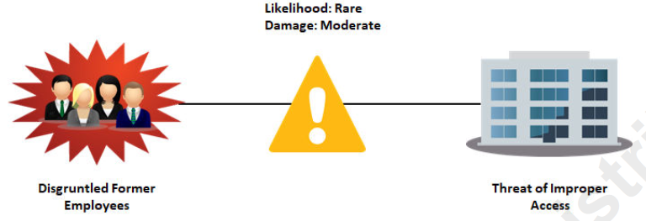
Risk
Risk is a concept that indicates exposure to the chance of damage or loss.
It signifies the likelihood of a hazard or dangerous threat occurring.

Slide 18
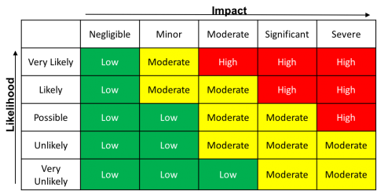
Risk
Risk = Likelihood X Impact

Slide 19
Vulnerability vs Threat vs Risk
First, a vulnerability exposes your system to a threat.
A threat is a malicious or negative event that takes advantage of a vulnerability.
Finally, the risk is the potential for loss and damage when the threat occurs.
RISK = VULNERABILITY X THREAT

Slide 20
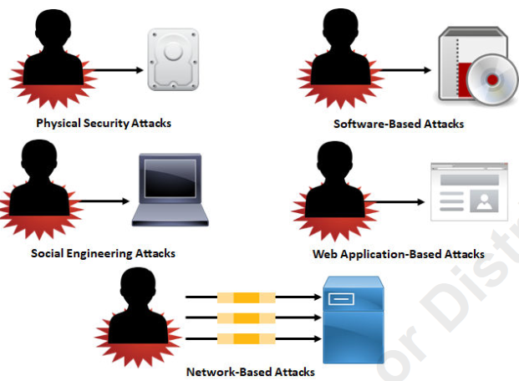
Attacks
An attack is a technique used to exploit a vulnerability in any application or physical computer system without the authorization to do so.
Attacks on a computer system and network security include:
• Physical security attacks.
• Software-based attacks.
• Social engineering attacks.
• Web application-based attacks.
• Network-based attacks, including wireless networks

Slide 21
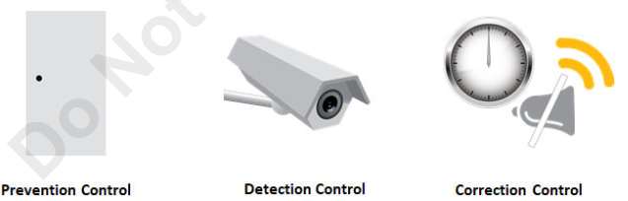
Security Controls
In the realm of computer security, controls are the countermeasures that you need to put in place to avoid, mitigate, or counteract security risks due to threats or attacks.
In other words, controls are solutions and activities that enable an organization to meet the objectives of an information security strategy.

Slide 22
Types of Security Controls
Mainly 3 types
Prevention Controls | Detection Controls | Correction Controls
These help to prevent a threat or attack from exposing a vulnerability in the computer system. For example, a security lock on a building's access door is a prevention control. | These help to discover if a threat or vulnerability has entered into the computer system. For example, surveillance cameras that record everything that happens in and around a building are detection controls. | These help to mitigate the consequences of a threat or attack from adversely affecting the computer system. For example, a security officer who responds to a silent alarm detecting an intrusion and who then stops the intruder is a correction control.

Slide 23
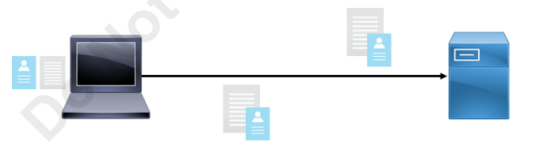
Non-Repudiation
Non-repudiation is the goal of ensuring that the party that sent a transmission or created data remains associated with that data and cannot deny sending or creating that data.
You should be able to independently verify the identity of a message sender, and the sender should be responsible for the message and its data.

Slide 24
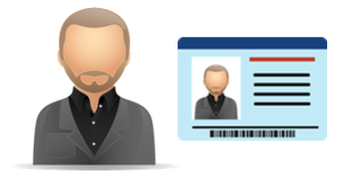
Identification
In security terms, identification is the process by which a claim is made about the nature of a particular entity.
Identification is what you show when someone wants proof of who you are.

Slide 25
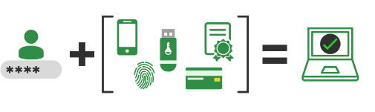
Authentication
Authentication is the method of validating a particular entity's or individual's identity and unique credentials.
Authentication concentrates on identifying if a particular individual has the right credentials to enter a system or secure site.
Authentication credentials should be kept secret to keep unauthorized individuals from gaining access to confidential information.

Slide 26
Authorization
In security terms, authorization is the process of determining what rights and privileges a particular entity has.
Authorization is equivalent to a security guard checking the guest list at an exclusive gathering, or checking for your ticket when you go to the movies.
After a user has been identified and authenticated, a system can then determine what rights and privileges that user should have to various resource:
Access Control
Accounting and Auditing
Principle of Least Privilege
Privilege Management

Slide 27
Protecting Your Computer and Its Content
Notes:
The first step in securing your digital assets is protecting your computer. This involves using antivirus software, applying regular updates, and maintaining strong passwords.

Slide 28
Overview
The first step in securing your digital assets is protecting your computer. Protecting your computer and its content is crucial in today’s digital age, where cyber threats are increasingly sophisticated.
Below are key strategies and best practices to safeguard your computer and data:
1. Use Strong Passwords and Multi-Factor Authentication (MFA)
2. Keep Software and Systems Updated
3. Install and Maintain Antivirus and Anti-Malware Software
4. Secure Your Network
5. Backup Your Data Regularly
6. Be Cautious with Email and Online Activities
7. Encrypt Sensitive Data
8. Limit User Privileges
9. Secure Physical Access
10. Educate Yourself and Stay Informed
11. Use Secure Cloud Services
12. Implement Data Loss Prevention (DLP)

Slide 29

Use Strong Passwords and Multi-Factor Authentication (MFA)

Slide 30
Precaution Steps
Strong Passwords: Create complex passwords that include a mix of uppercase and lowercase letters, numbers, and special characters. Avoid using easily guessable information like birthdays or common words.
Password Managers: Use a password manager to generate and store strong, unique passwords for each account.
Multi-Factor Authentication (MFA): Enable MFA wherever possible. This adds an extra layer of security by requiring a second form of verification (e.g., a code sent to your phone) in addition to your password.

Slide 31
Password Policy
The password policy is an important policy to both users and administrators.
The following outlines some of the considerations that should go into the password policy:
■ Minimum password length:
The minimum password length specifies how many characters users must have in their passwords.
The typical minimum length used by businesses is eight characters.
■ Password history
The password history setting specifies how many past passwords the system should keep track of.
The concept here is that users are not allowed to reuse a password in the password history.
Companies typically set the history to 12 or 24 passwords.
■ Maximum password age:
The maximum password age specifies how long an user is allowed to have a specific password.
This value is normally set anywhere from 30 to 60 days, at which time the user must change their password.

Slide 32
Password Policy (Cont…)
■ Minimum password age
The minimum password age is a minimum number of days that a user must have their password.
This setting prevents users from changing their password multiple times in order to get the desired password out of the history with the intent of reusing an old password.
■ Password complexity:
The password complexity setting specifies whether you require complex passwords.
A complex password is one that has a mix of letters, numbers, and symbols and uses a mix of uppercase and lowercase characters.
It is highly recommended to have password complexity enabled within your environment.

Slide 33
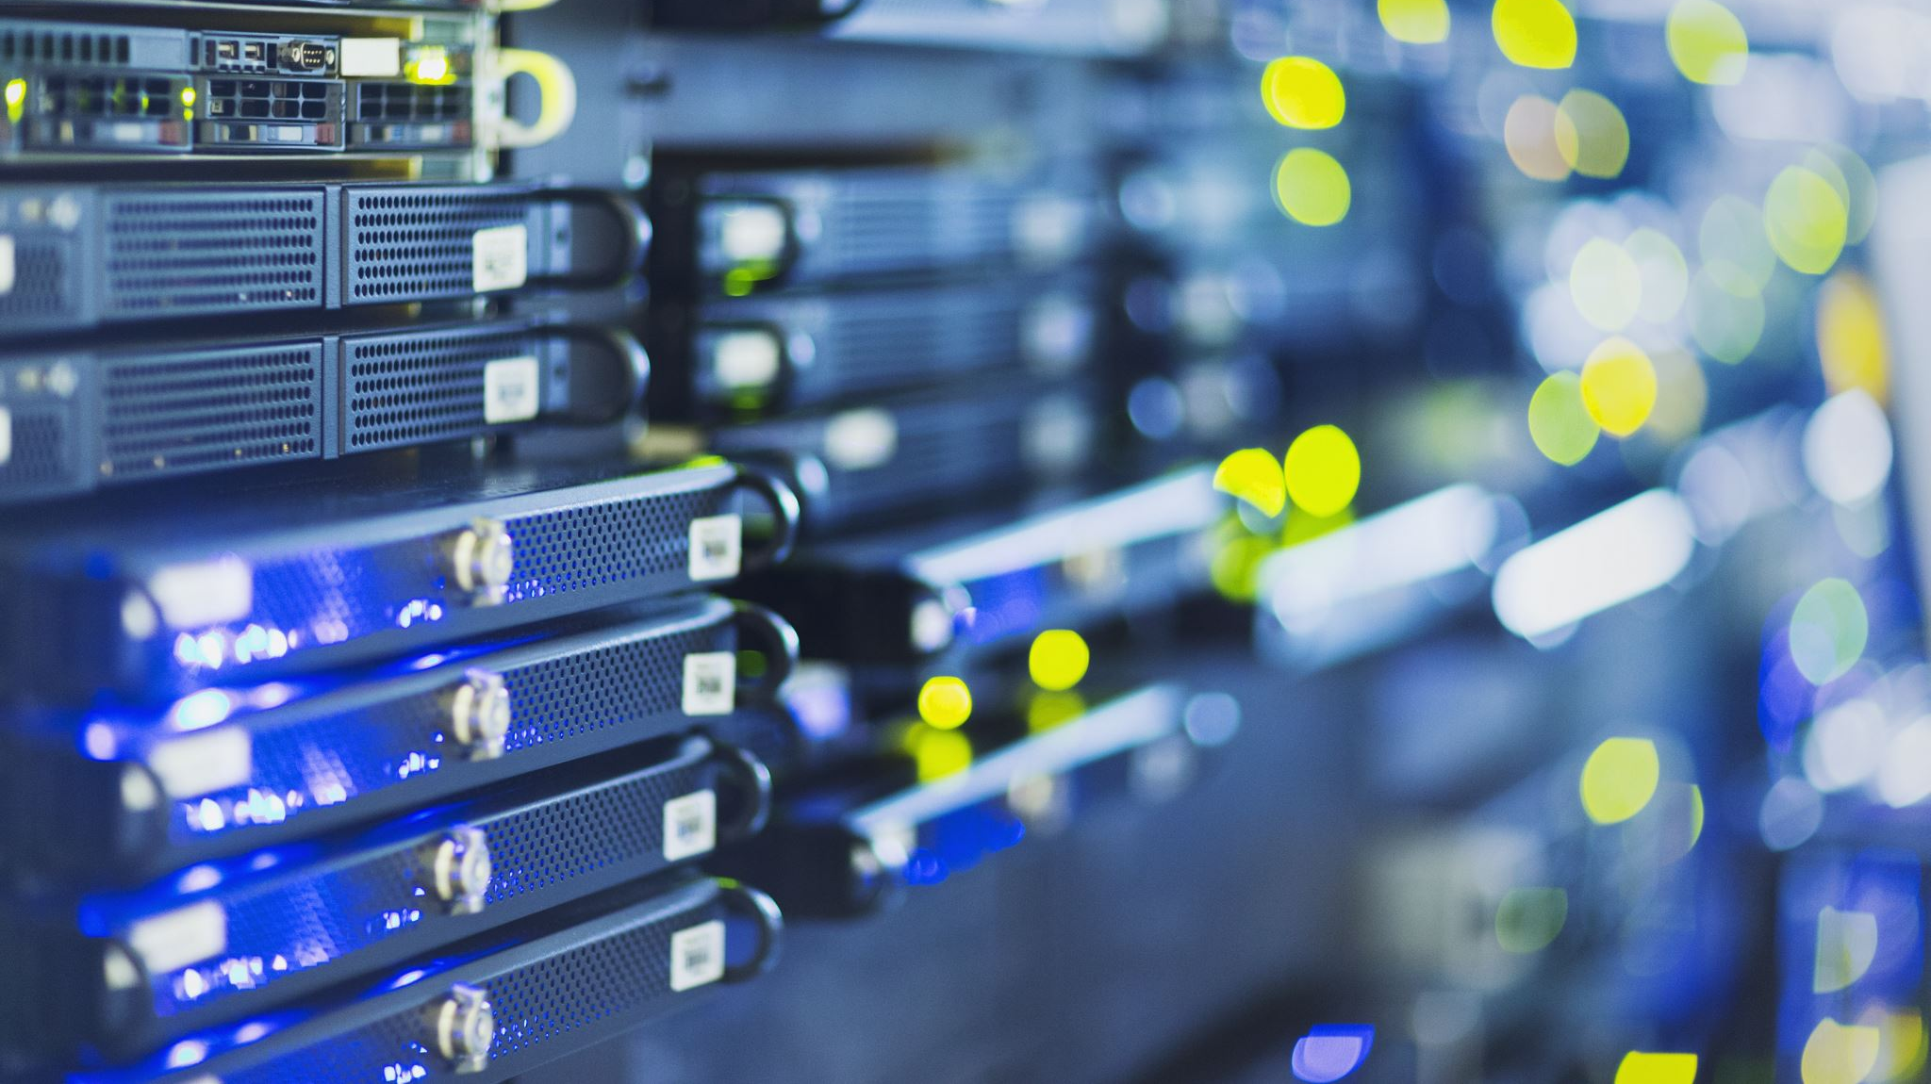
Keep Software and Systems Updated

Slide 34
Overview
Software updates or using licensed software is very important to prevent cyber attacks.
Not updating software regularly can have severe consequences for individuals, organizations, and entire networks.
Here are some key impacts:
1. Increased Security Vulnerabilities
2. Compliance and Legal Issues
3. Decreased System Performance and Reliability
4. Compatibility Issues
5. Data Loss and Corruption
6. Increased Maintenance Costs
7. Business Disruptions and Downtime

Slide 35
Operating System Updates: Regularly update your operating system to patch vulnerabilities and protect against known exploits.
Software Updates: Keep all software, including browsers, antivirus programs, and applications, up to date to ensure you have the latest security patches.
Automatic Updates: Enable automatic updates to ensure you don’t miss critical security fixes.

Slide 36
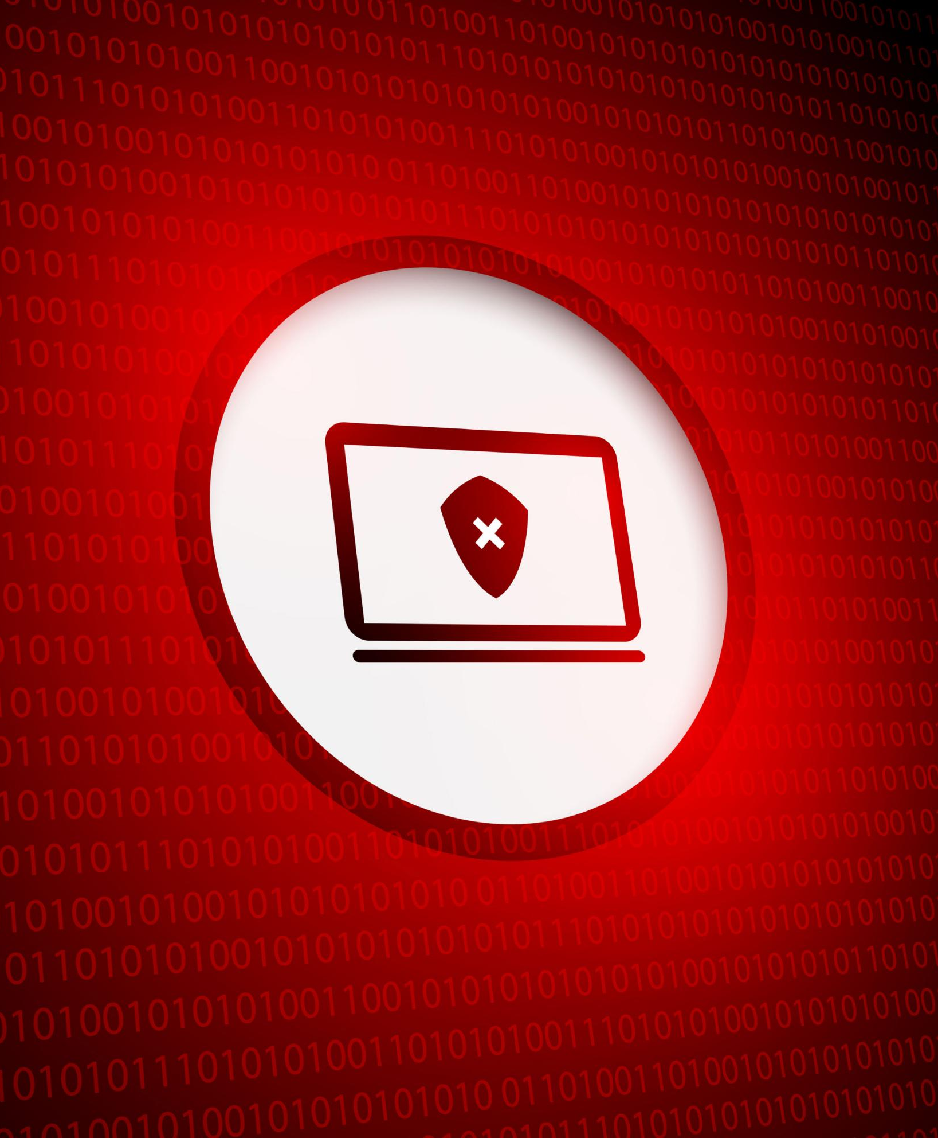
Importance of Antivirus Software
Antivirus software is essential for detecting and eliminating malware threats. It provides real-time protection against viruses, spyware, and other malicious software that can compromise your data.
Detecting Malware Threats
Antivirus software is crucial for identifying and removing malware threats that can harm your system.
Real-Time Protection
It offers real-time protection against various types of malicious software, ensuring your data remains safe.
Data Security
Antivirus software helps secure your sensitive data from unauthorized access and potential threats.
Notes:
Antivirus software is essential for detecting and eliminating malware threats. It provides real-time protection against viruses, spyware, and other malicious software that can compromise your data.

Slide 37
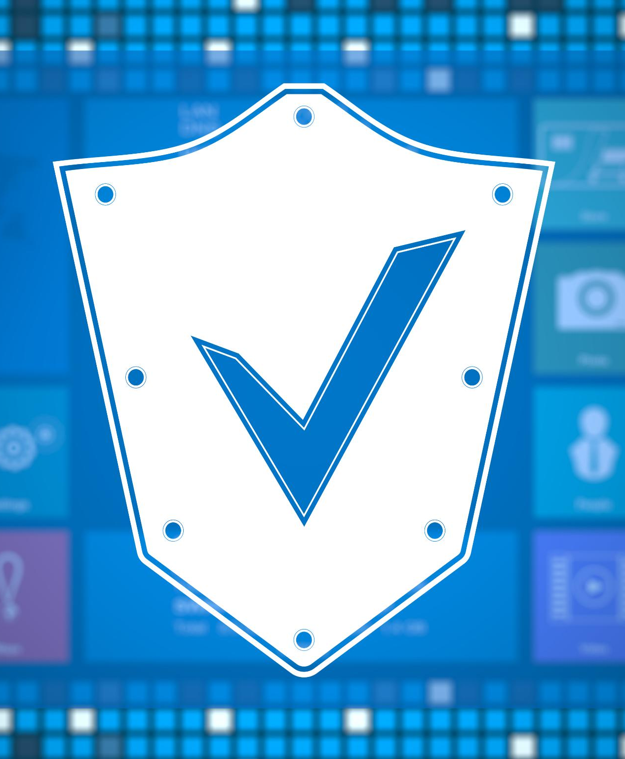
Importance of Regular Software Updates and Patches
Importance of Updates
Regular software updates are essential for maintaining security and functionality, helping to fix known vulnerabilities.
Patching Vulnerabilities
Updates often include patches that address vulnerabilities, preventing exploitation by attackers and enhancing overall security.
Risk Reduction
Regular updates significantly reduce the risk of security breaches, protecting personal and organizational data.
Notes:
Keeping software up to date is vital for security. Updates often include patches for vulnerabilities that could be exploited by attackers. Regularly updating your operating system and applications reduces the risk of breaches.

Slide 38
Implementing Strong Passwords and Encryption
Importance of Strong Passwords
Strong, unique passwords for each account are essential to protect against unauthorized access and data breaches.
Role of Encryption
Encryption safeguards sensitive data, making it unreadable to anyone without the proper key, enhancing overall security.
Preventing Data Interception
By implementing strong passwords and encryption, you can protect data from being intercepted and misused.
Notes:
Using strong, unique passwords for each account is a fundamental practice. Additionally, encryption can protect sensitive data, ensuring that even if it is intercepted, it remains unreadable without the proper key.

Slide 39
Securing Computer Networks and Handling Compromised Computers
Notes:
After securing individual devices, it's crucial to protect the entire network. This includes implementing strong network security measures and knowing how to respond to compromised systems.

Slide 40
Overview
After securing individual devices, it's crucial to protect the entire network.
This includes implementing strong network security measures and knowing how to respond to compromised systems.

Slide 41
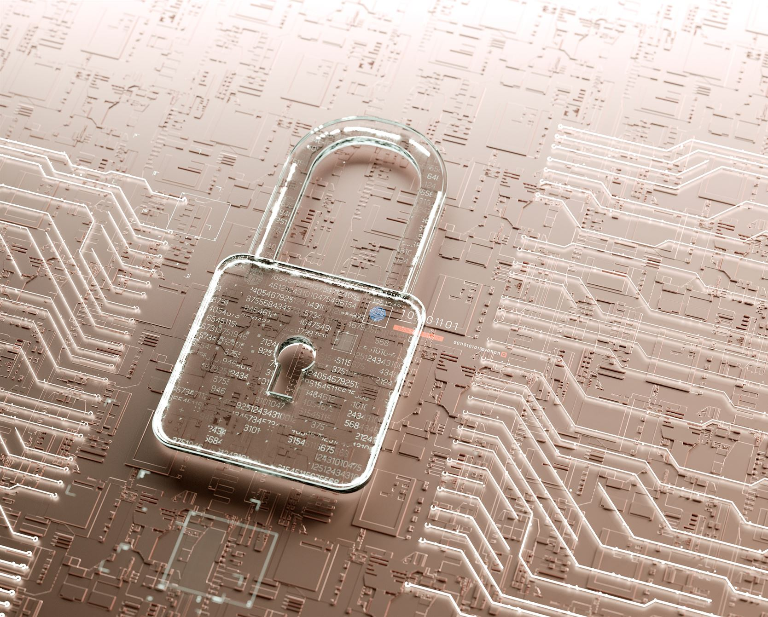
Network Security Measures (Firewalls, VPNs)
Importance of Firewalls
Firewalls are critical for monitoring and controlling network traffic. They help prevent unauthorized access to your networks.
Role of VPNs
VPNs encrypt internet connections, ensuring privacy and security while browsing online. They are vital for protecting sensitive information.
Notes:
Firewalls and Virtual Private Networks (VPNs) are essential tools for network security. Firewalls monitor and control incoming and outgoing network traffic, while VPNs encrypt your internet connection, enhancing privacy.

Slide 42
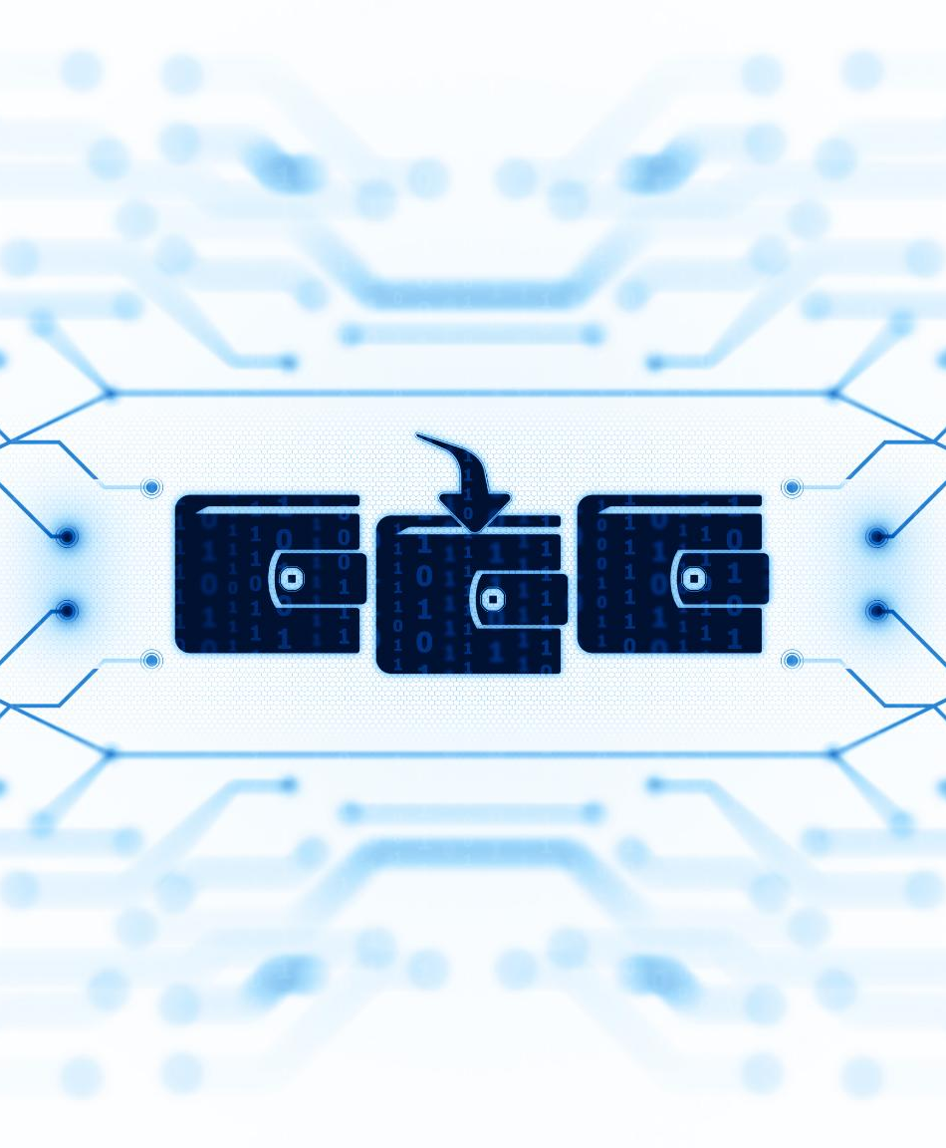
Identifying Signs of a Compromised Computer
Unusual Performance Issues
A compromised computer may exhibit slow performance, which can hinder productivity and indicate potential security threats. Sometimes programs take longer to load, or the system crashes frequently.
Unexpected Pop-Ups
Random ads or security warnings appear, especially if they urge you to take immediate action. Frequent unexpected pop-ups can be a sign of adware or malware infections that compromise computer security.
Unauthorized Access Attempts
Apps launch or close without user input. Unauthorized access attempts can signal a security breach, prompting users to take immediate action to secure their systems.
Notes:
Recognizing the signs of a compromised computer is crucial. Unusual behavior such as slow performance, unexpected pop-ups, and unauthorized access attempts can indicate a security breach.

Slide 43
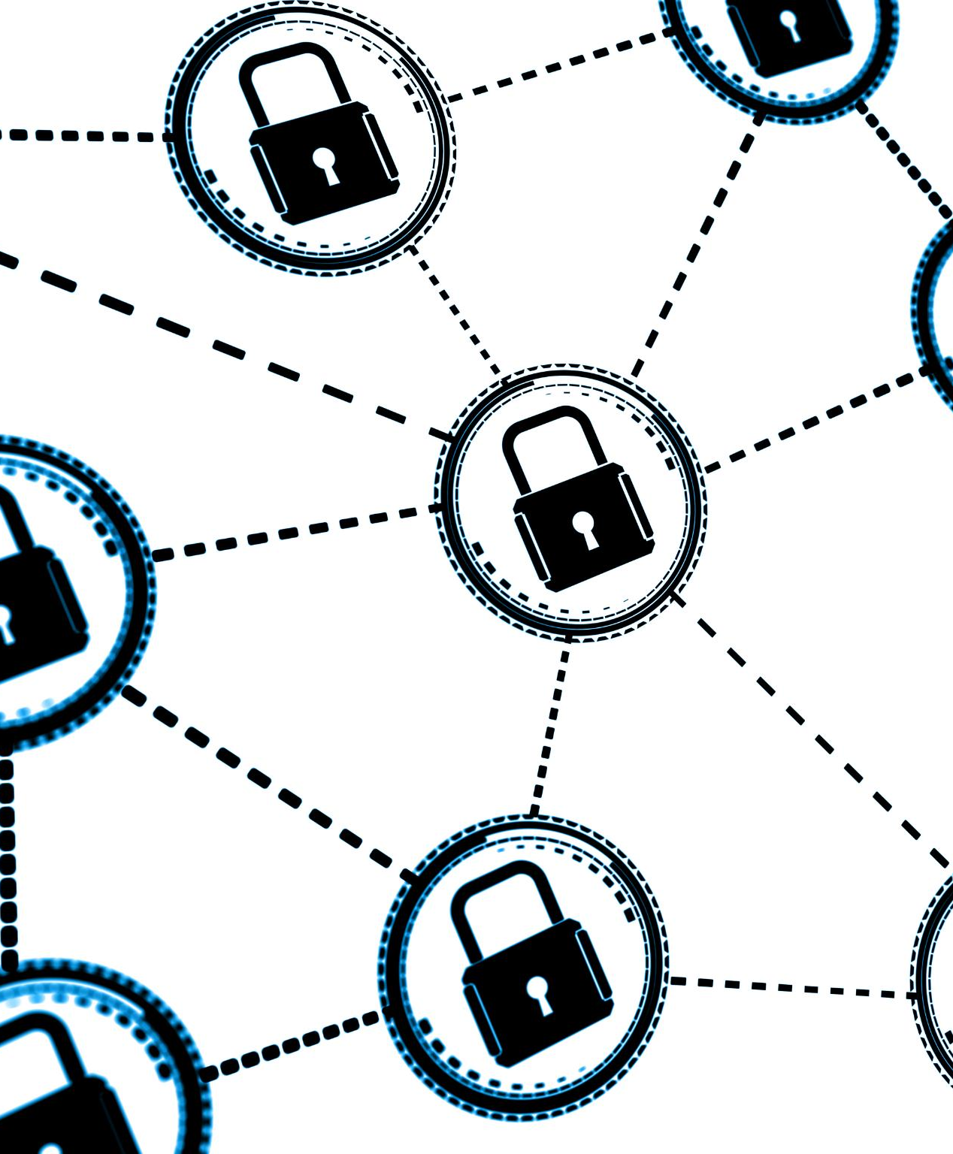
Steps to Take After a Security Breach
Immediate Disconnection
Disconnect the compromised device from the internet immediately to prevent further unauthorized access.
Change Passwords
Change all passwords associated with the compromised accounts to secure sensitive information from unauthorized access.
Malware Scan
Conduct a thorough scan for malware to identify and remove any malicious software that could cause further damage.
Notes:
In the event of a security breach, it's essential to act quickly. Disconnect the device from the internet, change passwords, and conduct a thorough scan for malware to mitigate damage.

Slide 44
Secure Communications
Notes:
Securing communications is vital to protect sensitive information. This section will cover encryption protocols and secure methods for sharing data.

Slide 45
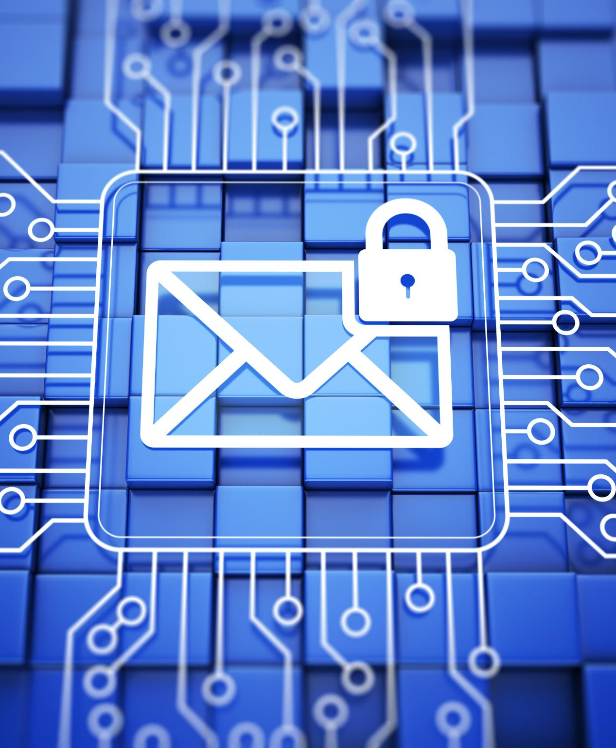
Encryption Protocols for Emails and Messages
Importance of Encryption
Encryption is vital for protecting sensitive communications from unauthorized access and ensuring confidentiality.
PGP Encryption
PGP (Pretty Good Privacy) is a widely used encryption standard that secures email communications effectively.
Secure Messaging Apps
Secure messaging apps utilize encryption protocols to ensure that private messages remain confidential.
Notes:
Using encryption protocols such as PGP (Pretty Good Privacy) for emails and secure messaging apps helps ensure that communications remain confidential and protected from unauthorized access.

Slide 46
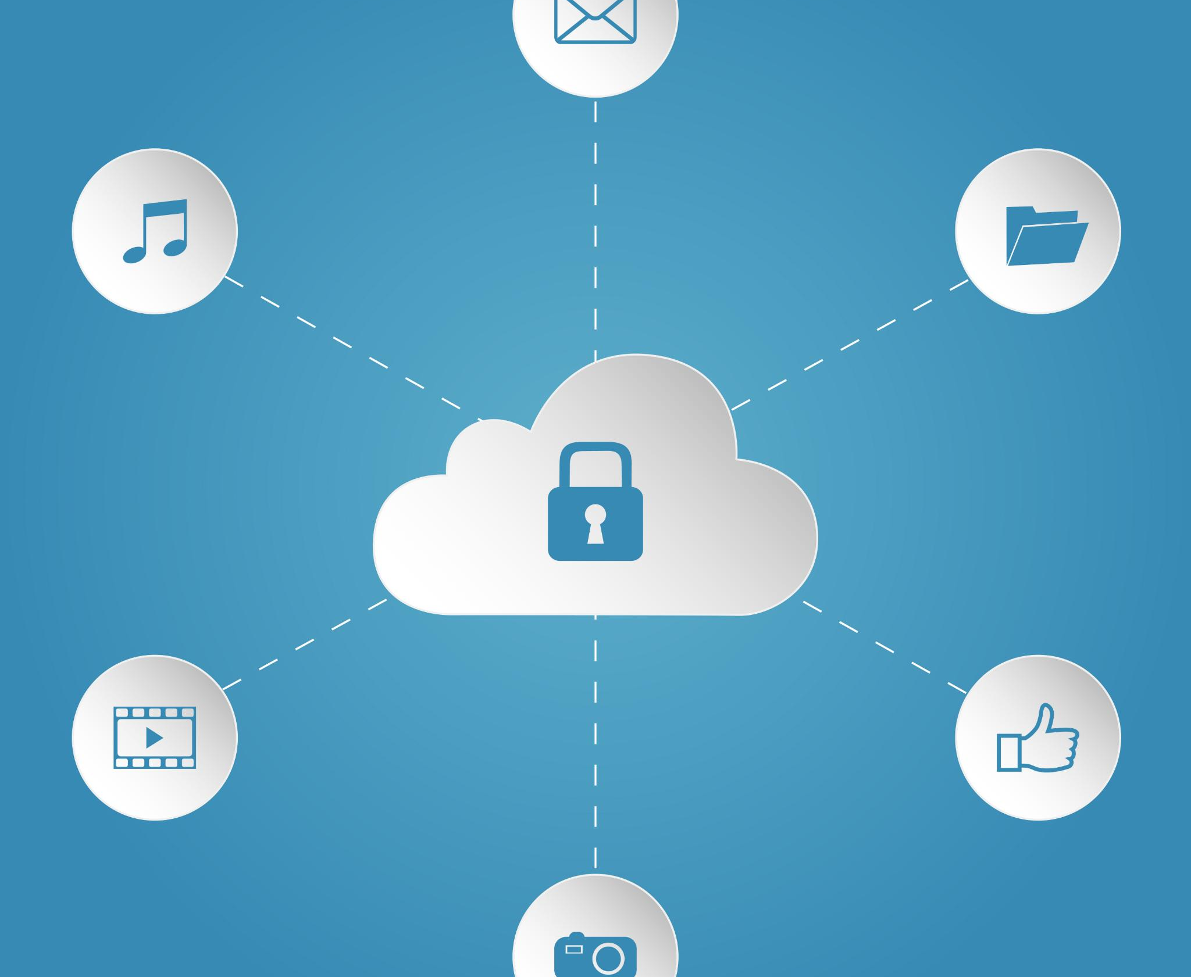
Secure File Transfer Methods
SFTP Protocol
SFTP, or Secure File Transfer Protocol, ensures secure file transfers over the internet by encrypting data during transmission.
Encrypted Cloud Storage
Using encrypted cloud storage services allows users to securely store and transfer sensitive files with added protection.
Notes:
When transferring files, use secure methods such as SFTP (Secure File Transfer Protocol) or encrypted cloud storage services to protect sensitive data during transmission.

Slide 47
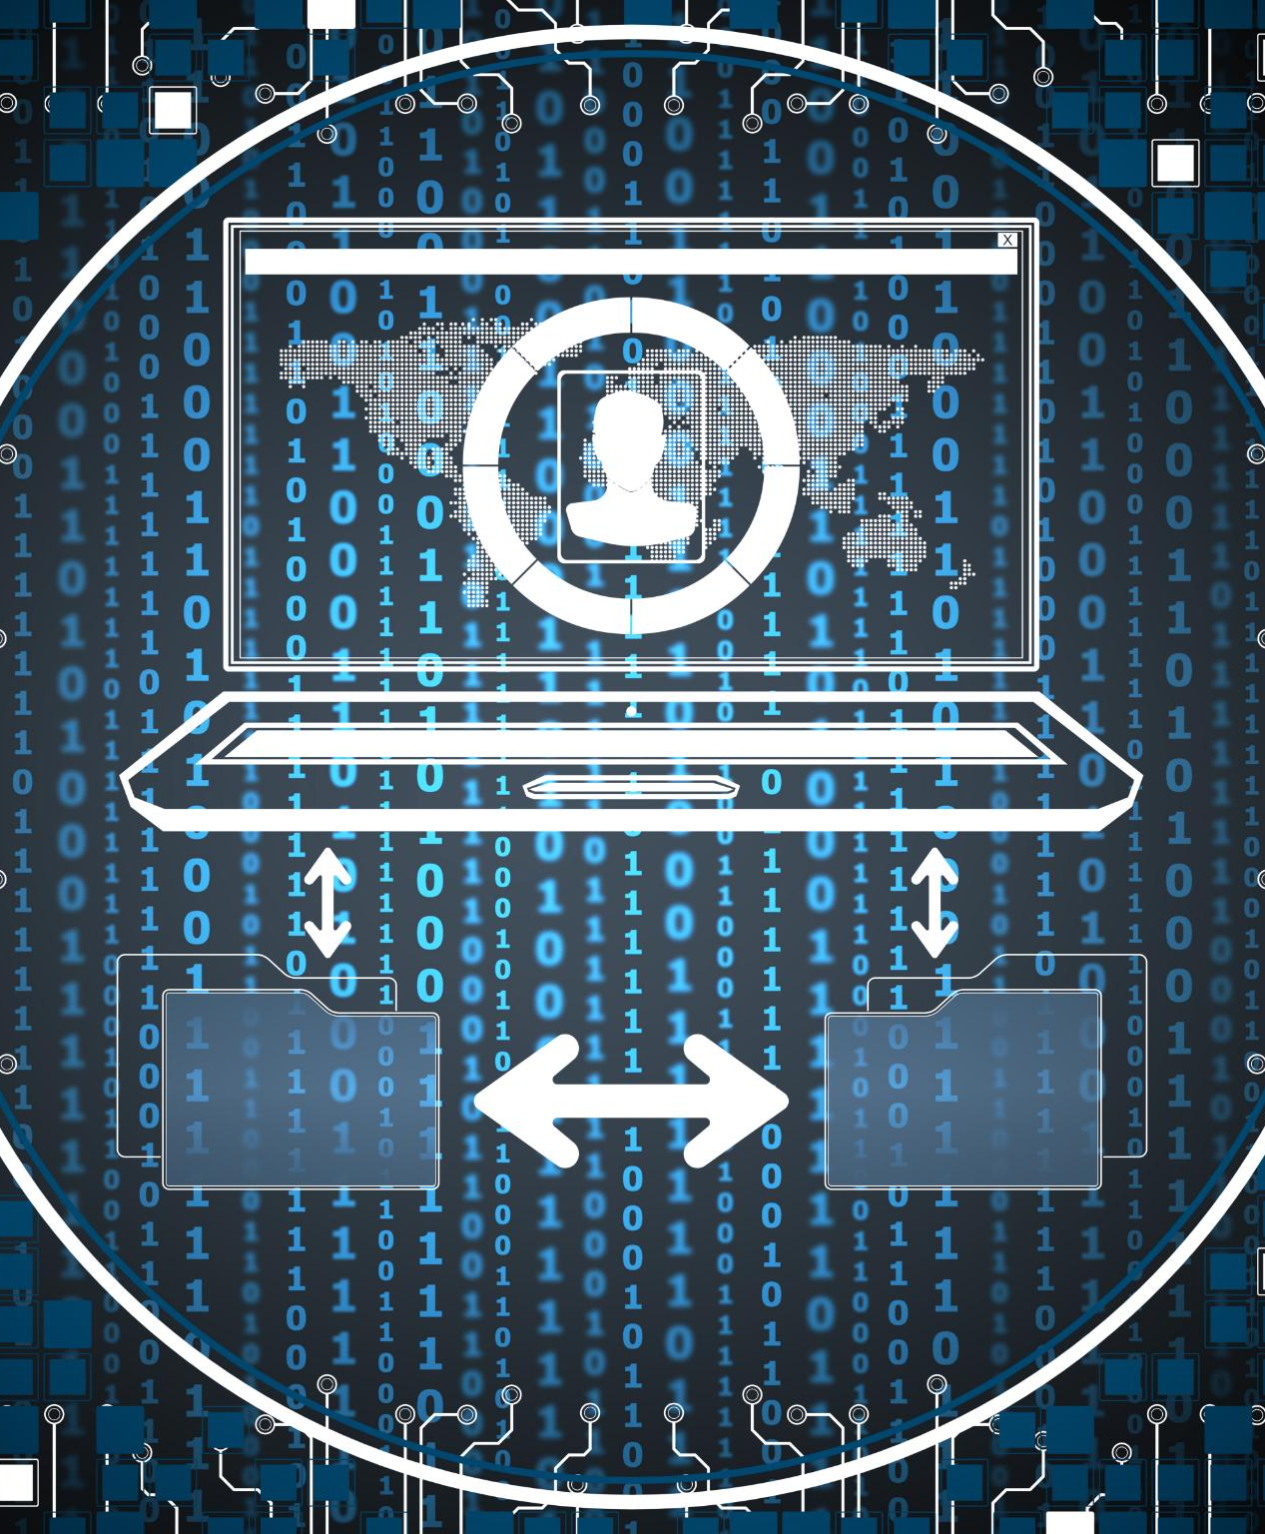
Using Secure Video Conferencing Tools
Importance of Security
As remote work increases, it is crucial to prioritize security in video conferencing tools to protect sensitive information.
End-to-End Encryption
Choose platforms that offer end-to-end encryption to ensure that your video calls are private and secure from interception.
Robust Privacy Controls
Look for platforms that provide robust privacy controls to manage who can access and view your video calls.
Notes:
With the rise of remote work, ensuring that video conferencing tools are secure is essential. Look for platforms that offer end-to-end encryption and robust privacy controls.

Slide 48
Information Security Best Practices
Notes:
Implementing best practices ensures a comprehensive approach to information security. This includes data management, access control, and regular assessments.

Slide 49

Data Backup and Recovery Strategies
Importance of Regular Backups
Regularly backing up data is essential to prevent loss due to cyberattacks or hardware failures.
On-Site Backup Solutions
Utilizing on-site backup solutions allows for quick data recovery and access, but poses risks if a disaster occurs.
Off-Site Backup Solutions
Off-site backup solutions, such as cloud storage, provide added security and redundancy for your data.
Notes:
Regularly backing up data is crucial for recovery in the event of data loss or cyberattacks. Consider both on-site and off-site backup solutions to ensure data integrity.

Slide 50
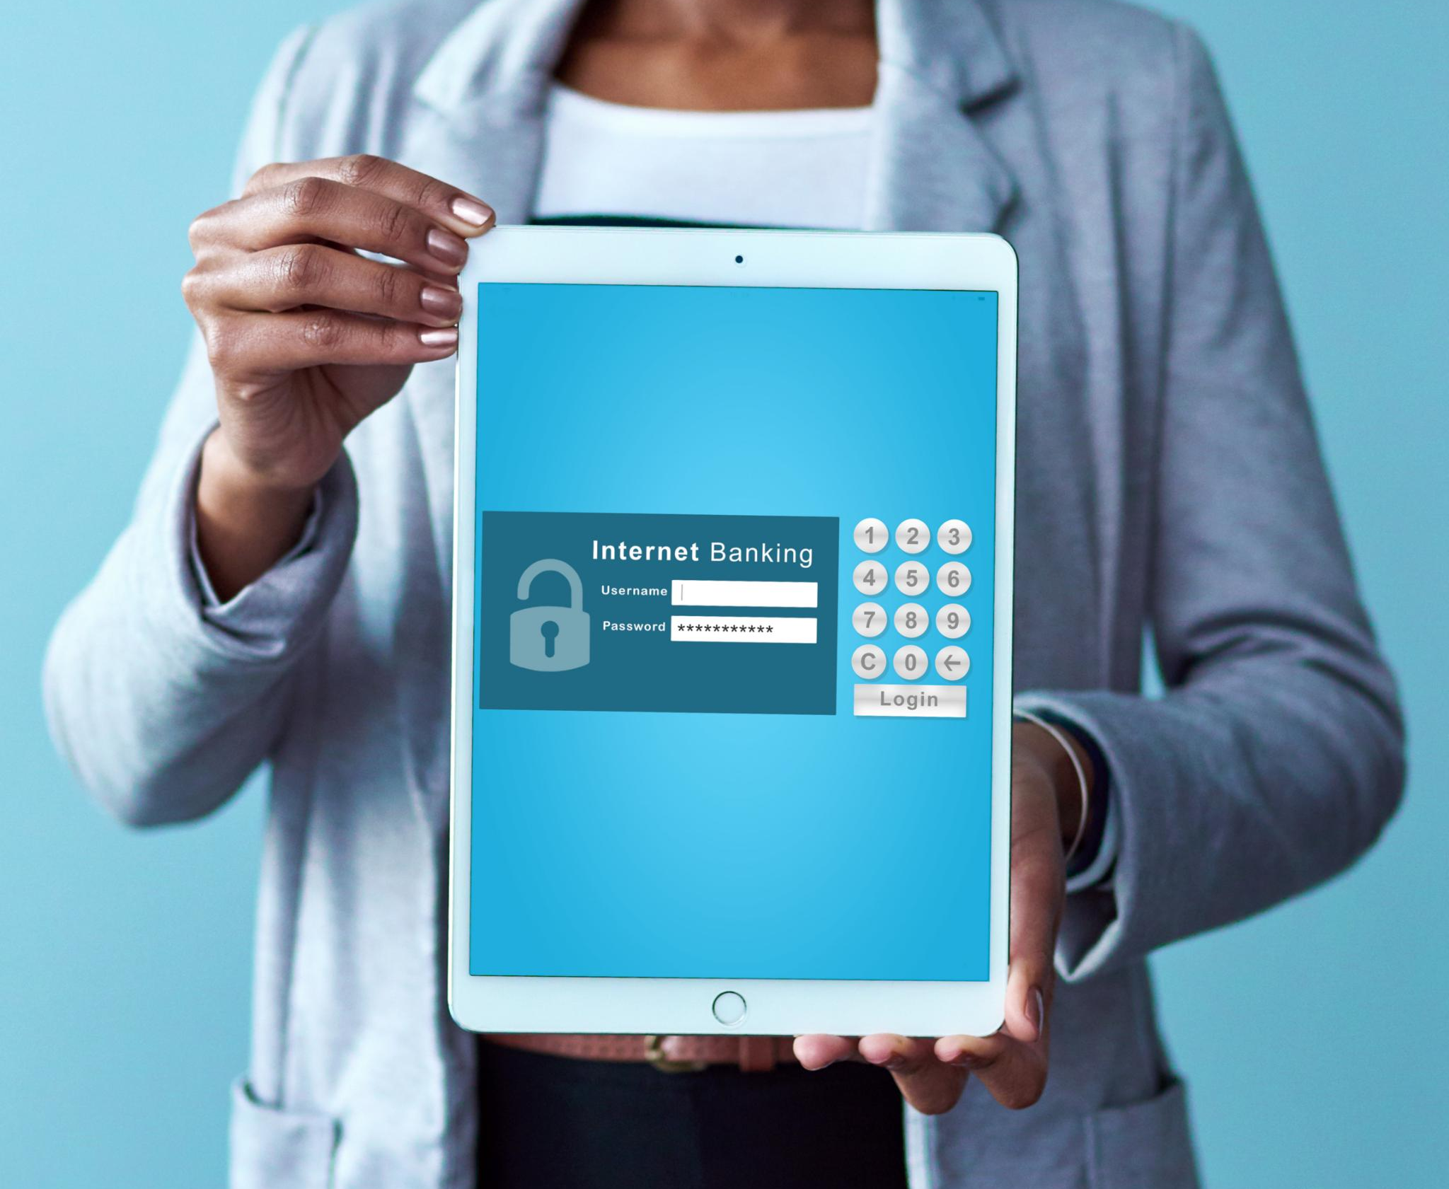
Implementing Access Controls and User Permissions
Purpose of Access Controls
Access controls are essential for limiting who can view or use organizational resources, thus enhancing security.
User Permissions Management
Implementing user permissions effectively protects sensitive information and minimizes the risk of unauthorized access.
Notes:
Access controls limit who can view or use resources within an organization. Implementing user permissions helps protect sensitive information and reduces the risk of unauthorized access.

Slide 51
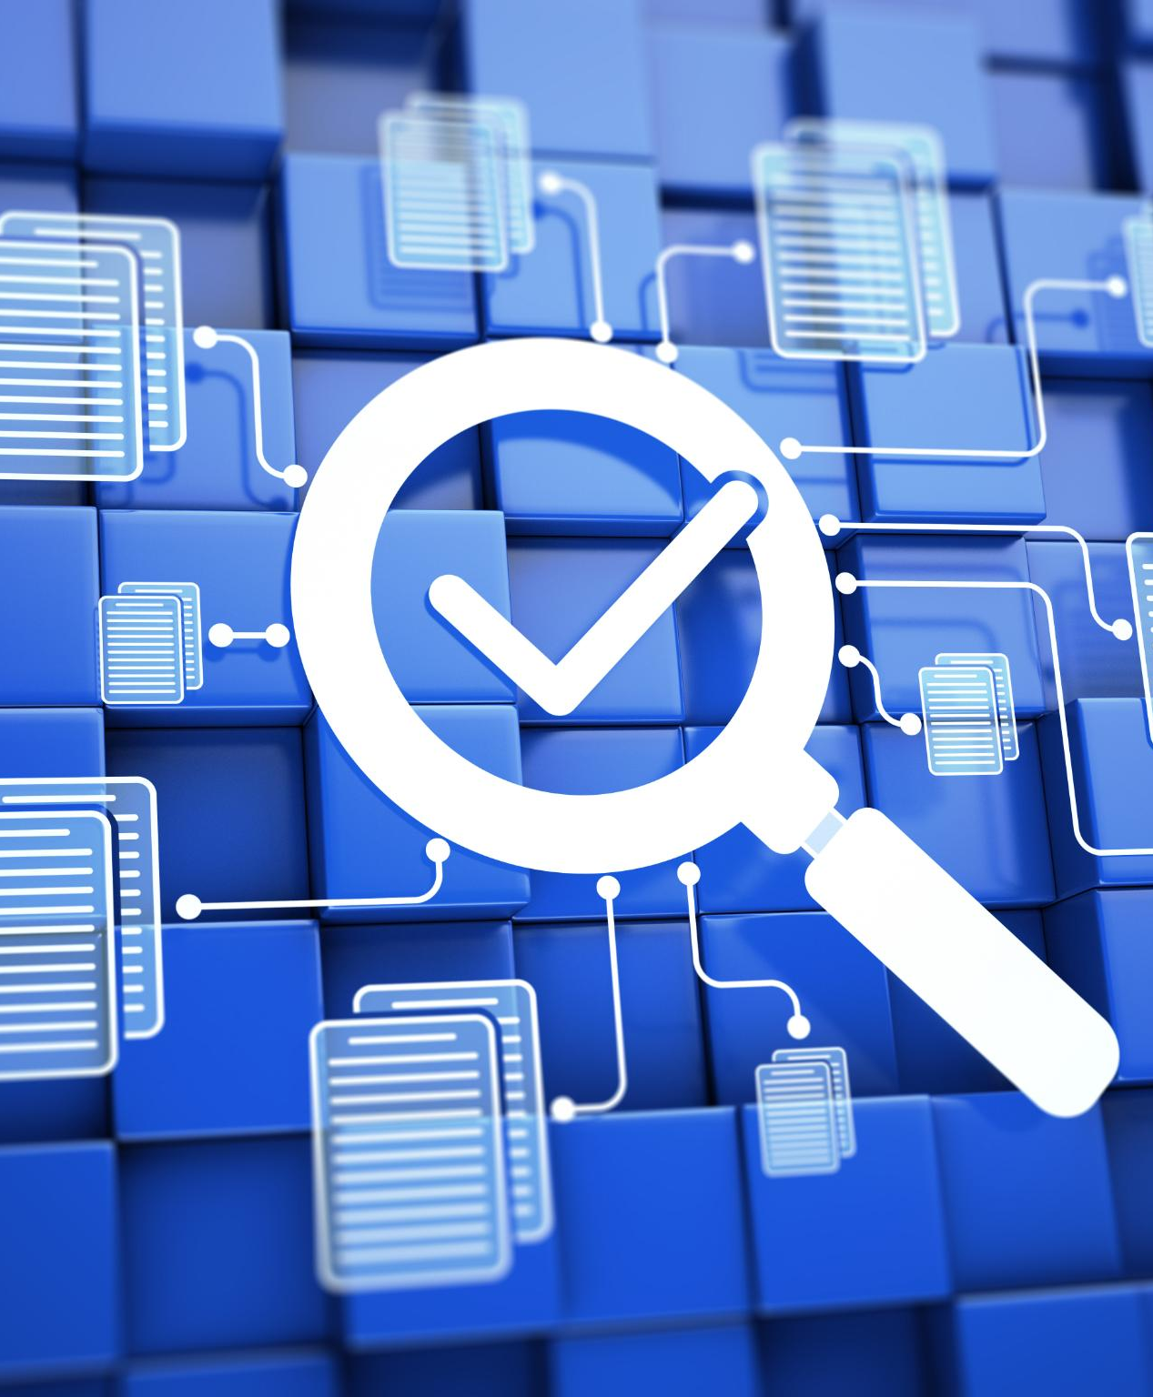
Regular Security Audits and Assessments
Identify Vulnerabilities
Routine security audits are essential for identifying vulnerabilities in your systems before they can be exploited.
Timely Updates
Regular security assessments ensure timely updates to defenses, keeping systems secure against emerging threats.
Enhanced Security Posture
Conducting these reviews enhances your overall security posture, making systems more resilient to attacks.
Notes:
Conducting routine security audits and assessments helps identify vulnerabilities within your systems. Regular reviews enable timely updates and enhance overall security posture.

Slide 52
Privacy Guidelines
Notes:
Understanding privacy guidelines is essential in protecting personal data. This section will cover laws, regulations, and best practices for maintaining privacy.

Slide 53
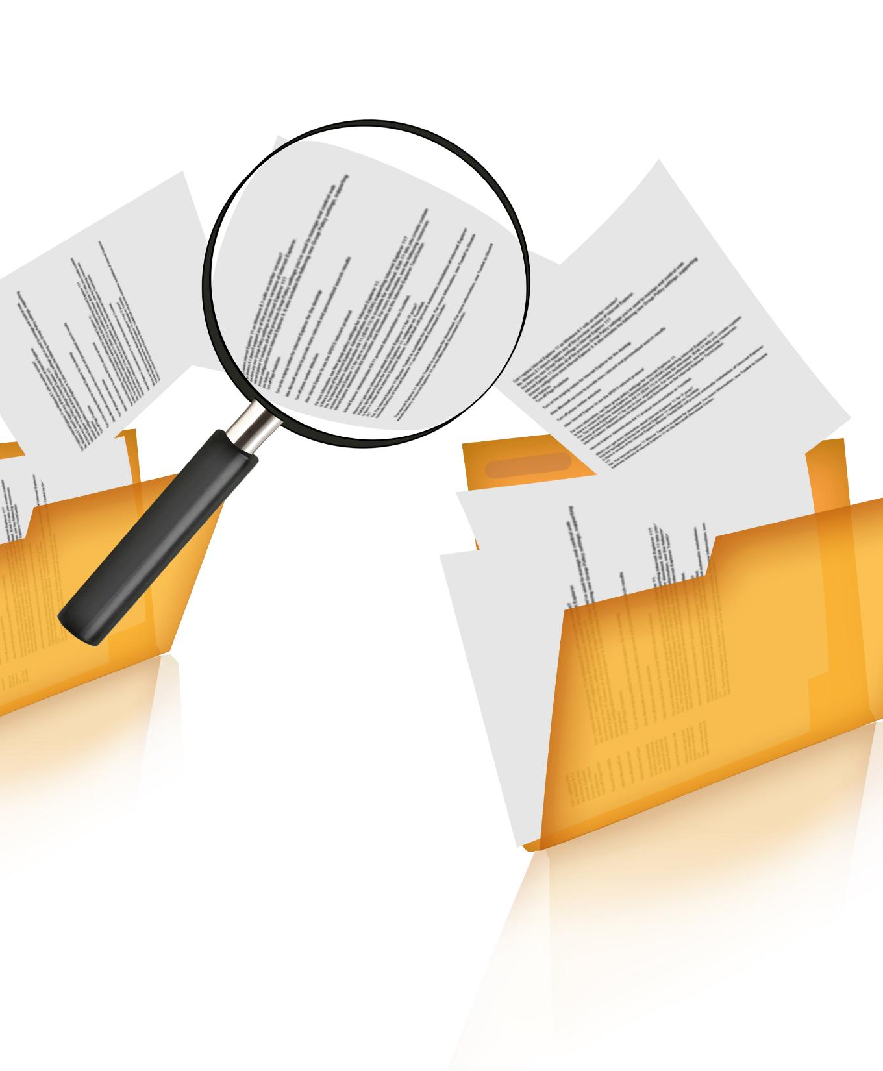
Understanding Data Privacy Laws and Regulations
Data Privacy Laws Overview
Understanding data privacy laws like GDPR and CCPA is essential for businesses handling personal data.
Importance of Compliance
Compliance refers to adhering to rules, regulations, laws, standards, or policies set by governing authorities, organizations, or industries.
It ensures that individuals or businesses operate ethically and within the established guidelines.
Compliance with data privacy regulations is crucial for protecting personal information from breaches and misuse.
Legal Consequences
Failing to comply with data privacy laws can result in significant legal issues and financial penalties for organizations.
Notes:
Familiarize yourself with data privacy laws such as GDPR and CCPA. Compliance with these regulations is crucial for protecting personal information and avoiding potential legal issues.

Slide 54
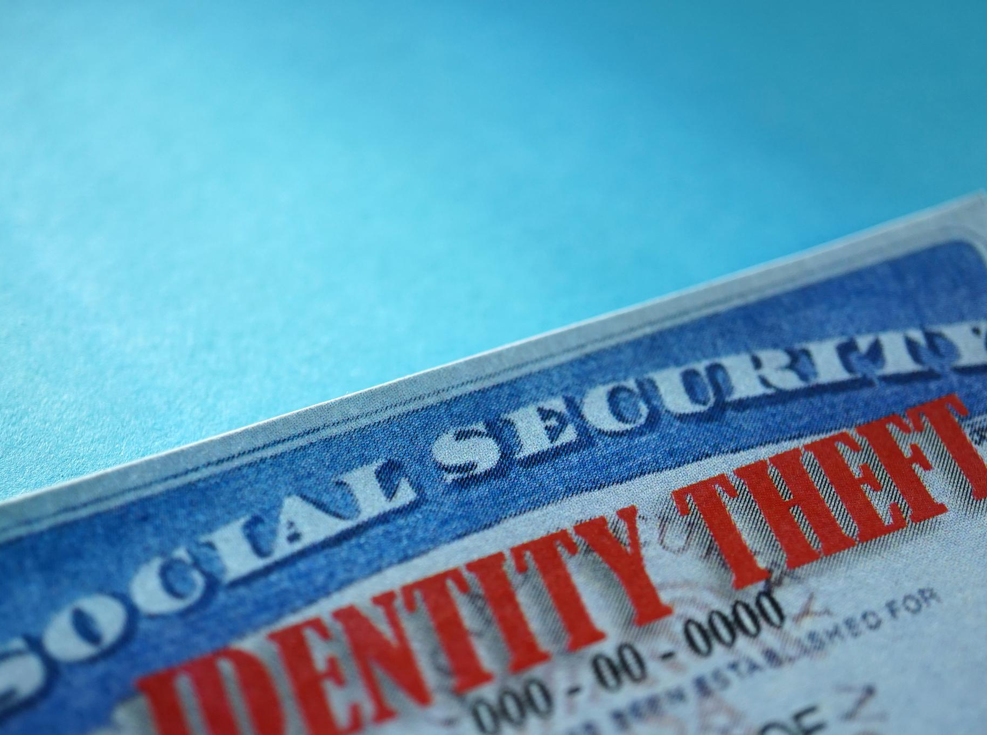
Protecting Personal Identifiable Information (PII)
Importance of PII Protection
Protecting PII is essential for preventing identity theft and fraud, which can have serious consequences.
Encryption Techniques
Using encryption is a key method to protect sensitive information from unauthorized access.
Access Controls
Implementing strong access controls ensures that only authorized personnel can access PII.
Awareness Training
Providing awareness training is crucial for educating employees about best practices for safeguarding PII.
Notes:
Protecting PII is vital for preventing identity theft and fraud. Use encryption, access controls, and awareness training to safeguard this sensitive information.

Slide 55
Best Practices for Social Media Privacy
Adjust Privacy Settings
Regularly adjust your privacy settings to control who can see your posts and personal information.
Cautious Sharing
Be cautious about the personal information you share online, as it can be used for identity theft or harassment.
Review Account Security
Regularly review your account's security, including passwords and login alerts, to enhance your protection.
Notes:
Maintain privacy on social media by adjusting privacy settings, being cautious with personal information shared online, and regularly reviewing your account's security.

Slide 56
Safe Internet Usage
Notes:
Practicing safe internet usage helps mitigate risks while online. This includes recognizing threats and adopting safe browsing habits.

Slide 57
Recognizing Phishing and Scam Websites
Identifying Suspicious Emails
Learn to recognize the signs of phishing emails, such as poor grammar, unexpected attachments, or generic greetings.
Verifying Sources
Always verify the source of emails and links before clicking to prevent falling victim to scams.
Common Scam Characteristics
Familiarize yourself with common characteristics of scam websites, including poor design and unusual URLs.
Notes:
Phishing scams are prevalent. Learn to identify suspicious emails and websites to avoid falling victim to fraud. Always verify the source before clicking on links.

Slide 58

Safe Browsing Habits (Using HTTPS, Avoiding Public Wi-Fi)
Importance of HTTPS
Using HTTPS ensures a secure connection, protecting your data from potential eavesdroppers during online transactions.
Risks of Public Wi-Fi
Public Wi-Fi networks can expose your sensitive information to cybercriminals. It's best to avoid using them for important transactions.
Notes:
Adopting safe browsing habits is essential. Always use HTTPS for secure connections and avoid public Wi-Fi for sensitive transactions to reduce the risk of eavesdropping.

Slide 59
Educating Users on Safe Online Behavior
Importance of Education
Education is essential for building a strong security culture within an organization. It helps users understand potential risks and best practices.
Regular Training Sessions
Conducting regular training sessions keeps security awareness fresh in users' minds. This ongoing education is crucial for effective threat recognition.
Empowering Users
Empowering users with knowledge enables them to recognize and respond to security threats confidently, enhancing overall cybersecurity.
Notes:
Education is key to fostering a culture of security. Regular training sessions on safe online behavior can empower users to recognize and respond to potential threats.

Slide 60
Conclusion
Proactive Security Measures
A proactive approach is essential for protecting digital assets from potential threats and vulnerabilities.
Essential Security Practices
Implementing essential security practices can significantly enhance information protection and mitigate risks.
Safeguarding Information
Safeguarding digital information is crucial for both individuals and organizations to prevent data breaches.
Notes:
In conclusion, protecting digital assets requires a proactive approach. By implementing these essential practices, individuals and organizations can significantly enhance their information security and safeguard against potential threats.

